Slide 1

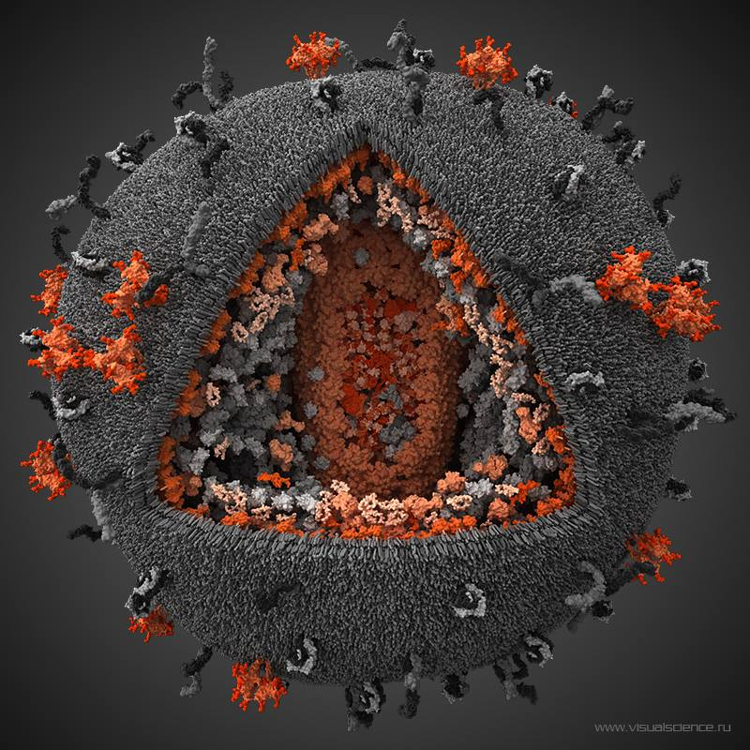
Silencing the HIV reservoir
The block-and-lock approach
Susana Valente, PhD
Department of Immunology and Microbiology
The Scripps Research Institute
Jupiter, Florida
HIV Cure Research with the Community Workshop
July 21st 2018

Slide 2
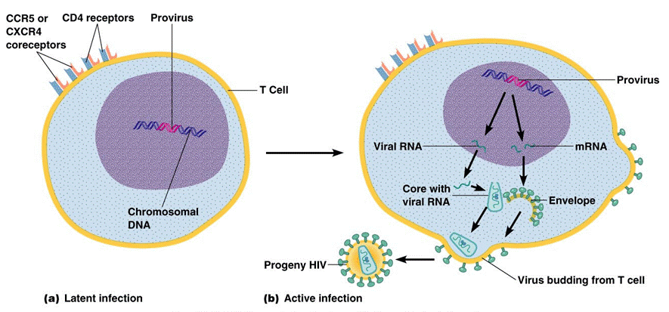
Comparison of latent and active infection

Slide 3
In latency, the virus hibernates. This allows life-long persistence of the virus.
The removal of the latent virus is a significant challenge.

Slide 4

Sterilizing cure - all virus has been eliminated from the body-
the Berlin Patient.
Remission/control or Functional cure - virus remains but doesn’t rebound after antiviral cocktails are removed-
Visconti subjects
French Teenager

Slide 5
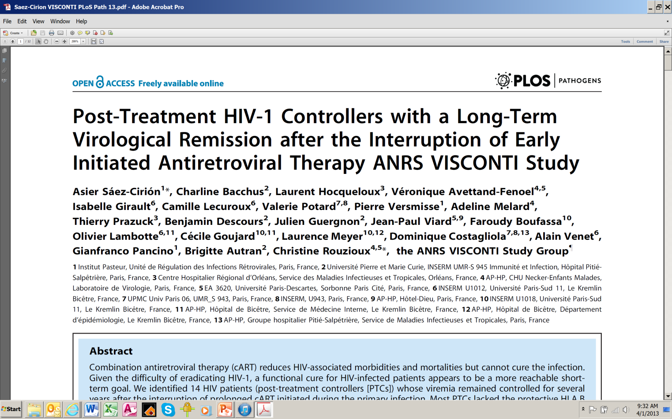

20 adults (and one child) who started therapy early (but not in “hyperacute” stage), remained on therapy for years, and had no rebound after stopping therapy
Virus still remains detectable in blood but under control-even in absence of ART- functional cure?

Slide 6
Strategies that keep the virus in hibernation “block-and-lock” need to be explored.

Slide 7

What is exactly the “Block-and-Lock” approach?
HIV infection is characterized by high levels of circulating viruses in the blood
Antiretroviral therapy (ART) is capable of suppressing HIV to undetectable levels
However, the virus rebounds after cessation of therapy
START
STOP
ART
Circulating virus
Limit of detection
Blips
Time
Notes:
It has been demonstrated that the decay of the viral reservoir in patients with no “blips”, or episodes of clinically detectable viremia from reservoir reactivation, is faster than in patients with blips (Ramratnam et al, 2000. Nat Med; Siliciano JD et al, 2003, Nat Med).

Slide 8
What is exactly the “Block-and-Lock” approach?
HIV infection is characterized by high levels of circulating viruses in the blood
Antiretroviral therapy (ART) is capable of suppressing HIV to undetectable levels
However, the virus rebounds after cessation of therapy
START
STOP
ART + Transcriptional
inhibitor
ART
Circulating virus
Deep latency
Limit of detection
Blips
Time
This approach that may reduce the size of the latent reservoir pool by blocking ongoing viral replication and preventing replenishment of the latent viral reservoir
Notes:
It has been demonstrated that the decay of the viral reservoir in patients with no “blips”, or episodes of clinically detectable viremia from reservoir reactivation, is faster than in patients with blips (Ramratnam et al, 2000. Nat Med; Siliciano JD et al, 2003, Nat Med).

Slide 9
What is exactly the “Block-and-Lock” approach?
HIV infection is characterized by high levels of circulating viruses in the blood
Antiretroviral therapy (ART) is capable of suppressing HIV to undetectable levels
However, the virus rebounds after cessation of therapy
Virus remians contained after cessation of therapy
START
STOP
ART
Circulating virus
Deep latency
Limit of detection
Blips
Time
This approach that may reduce the size of the latent reservoir pool by blocking ongoing viral replication and preventing replenishment of the latent viral reservoir
Notes:
It has been demonstrated that the decay of the viral reservoir in patients with no “blips”, or episodes of clinically detectable viremia from reservoir reactivation, is faster than in patients with blips (Ramratnam et al, 2000. Nat Med; Siliciano JD et al, 2003, Nat Med).

Slide 10
In sum, the block-and-lock…
… supports the use of specific HIV-1 transcriptional inhibitors, to promote a more durable state of latency, less susceptible to spontaneous reactivation during ART and when ART is discontinued (“deep” latency).
… by silencing viral transcription, the size of the latent reservoir might decrease through the efficient suppression of reactivations episodes (“blips”) suspected to participate in reservoir replenishment.

Slide 11
In human cells, the default state of gene expression is "off" rather than "on"
Of the estimate 20,000-25,000 genes in a cell, only ~ 8,000 are expressed. Some are needed for maintenance of cell functions, others have roles specific to certain tissues or cell types; for example only the pancreas produces insulin.
Why is this the case?
  The secret lies in chromatin which can repackage DNA in more open or close configurations

Slide 12
Current strategies aimed at blocking HIV-1 reactivation:
1- inhibition/degradation of the viral Tat transactivator (dCA and triptolide)
2 - inhibition of HSP90 protein (GV1001), resulting in the suppression of HSP90-dependent NF-kB pathway
3 - inducing a change in the nuclear localization of the HIV-1 integration site (LEDGIN).

Slide 13
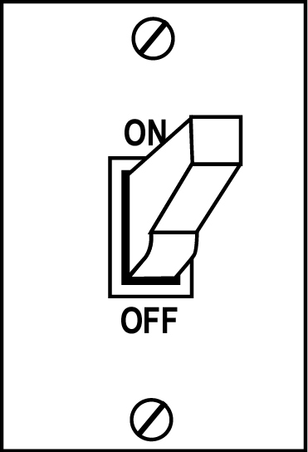
Tat regulates passage from latent to active infection
Tat
Active replication
Novel class of inhibitors:
Tat inhibitors
didehydro-Cortistatin A
dCA
Latency
Tat – Transcriptional trans activator

Slide 14
dCA efficacy in BLT humanized mouse models
dCA was added to ART for a period of 14 days
Kessing et al., 2017, Cell Reports
Two weeks dCA treatment results in approximately 1 log reduction in HIV RNA
In the brain dCA decrease by 7-fold HIV-1 mRNA compared to control mice

Slide 15
dCA efficacy in BLT humanized mouse models
dCA was added to ART for a period of 30 days
Four weeks dCA treatment significantly delays and reduces viral rebound levels
reduces viral rebound levels
Kessing et al., 2017, Cell Reports

Slide 16
Additional benefits of Tat inhibitors
Reduction of Tat mediated HIV-1-associated neurocognitive disorders
Reduction of chronic immune activation that comes from ongoing viral production even during suppressive therapy
Virus may develop less resistance since these types of inhibitors (transcriptional inhibitors) uses both viral and cellular components.

Slide 17
Many, many, questions still remain….
Transcriptional inhibitors are unlike any other HIV inhibitor, as duration of treatment impacts the outcome, because of the feedback nature of the Tat activity and because epigenetic marks at the HIV-1 promoter accrue over time.
It is essential to understand their full clinical potential:
How long should the treatment be to totally inhibit residual viral production?
What is the relationship between HIV inhibition and time to rebound after treatment interruption?
Can we remove all therapy altogether or should the transcriptional inhibitor be maintained to keep viral production undetectable?
VERY IMPORTANT - Can it become a permanent block?

Slide 18
Hurdles to an effective Shock-and-kill
Levels of reactivation needed to trigger kill not achieved
Risky! Non-specificity of the Latency reversing agents…cancers?
HIV-1 latency is an heterogeneous process…how many shocks will it take?
Suboptimal tissue ART concentrations may lead to reinfection!
Risky! The brain reservoir has poor immune surveillance…no kill… neurocognitive disorders?

